Slide 2
Aim
I can understand different feelings that humans can experience.
Success Criteria
I can explain what stresses and worries are.
I understand why I have stresses and worries.
I know how stresses and worries feel.
This resource is fully in line with the Learning Outcomes and Core Themes outlined in the PSHE Association’s Programme of Study.

Slide 3




The Big Questions
Why do we
feel worried or stressed during our lives?
How can we make these feelings OK
for our wellbeing?

Slide 4

What Are Stresses and Worries?
Lots of different things can make you feel stressed or worried.
Have you ever had a funny feeling in your tummy when you do something new or when you feel a bit worried?
Have you ever
found it hard to
sleep because you
are worried
about something?

Slide 5


What Are Stresses and Worries?
Lots of different things can make you feel stressed or worried.
The feelings you are
having are called
stresses or worries.
You might have
heard grown-ups
talk about ‘stress’
or ‘feeling stressed’.

Slide 6
What Are Stresses and Worries?
Can you think of a time you might have felt stressed or worried?
Spend a few moments thinking about this. You don’t need to talk to anyone about it but you can if you would like to.

Slide 7

What Are Stresses and Worries?
Things that cause stresses or worries can be different for each
of us and they can depend on who you are and your life.
Situations that can make lots of people
feel stressed or worried include:

Slide 8
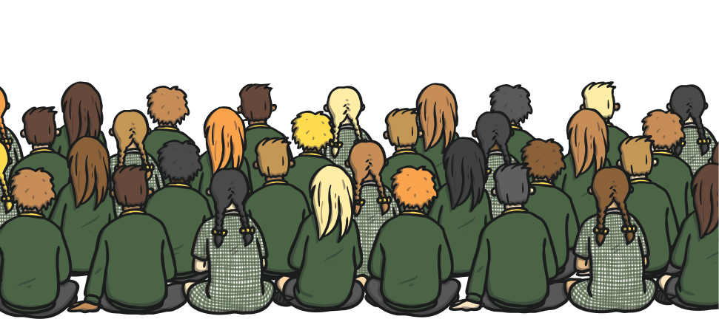
What Are Stresses and Worries?
standing up and talking in front of the whole school

Slide 9
What Are Stresses and Worries?
crossing a busy road

Slide 10
What Are Stresses and Worries?
starting school

Slide 11
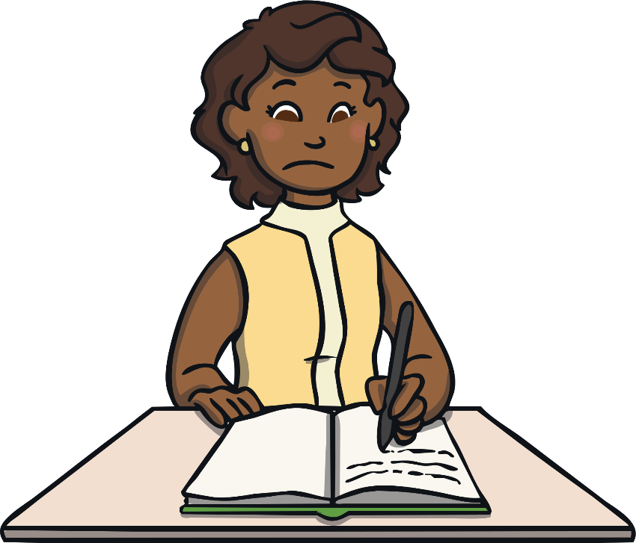
What Are Stresses and Worries?
?
?
?
being given work to do that you find very difficult

Slide 12
What Are Stresses and Worries?
when you are shopping and you can’t see your grown-up

Slide 13
What Are Stresses and Worries?
when you and a friend
are having difficulties

Slide 14
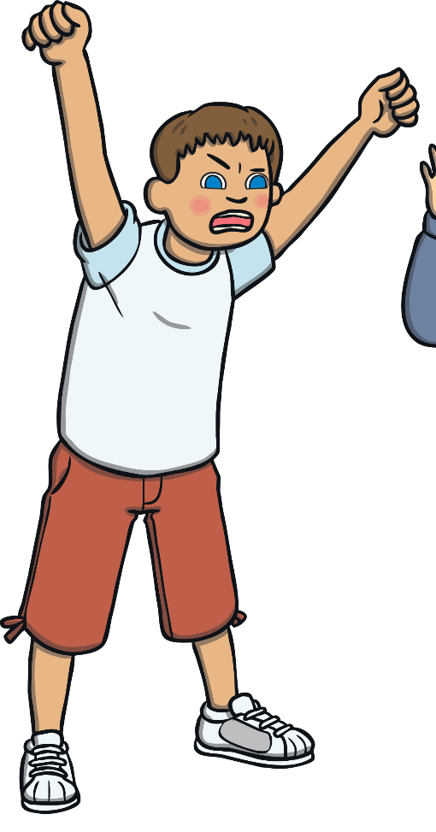
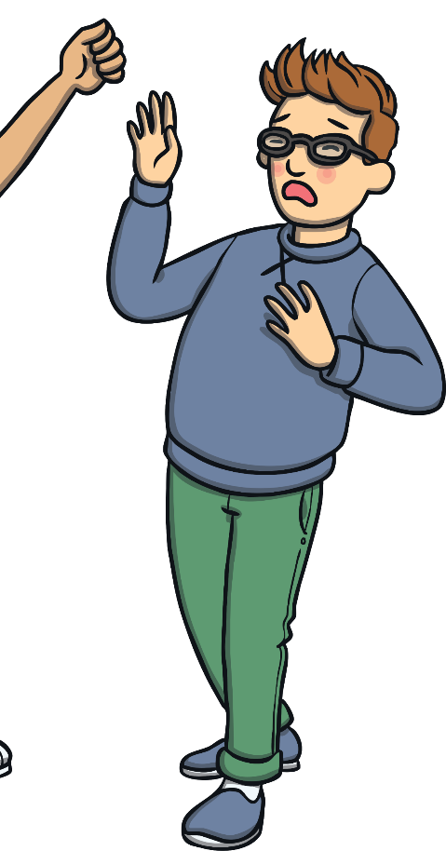
What Are Stresses and Worries?
when you have an argument with someone

Slide 15
What Do Stresses and
Worries Feel Like?
Stress is a word to explain the feeling you have when you are worried about something or don’t feel comfortable about something.
This worrying in
your mind can
make your body
feel uncomfortable
as well.

Slide 16
What Do Stresses and
Worries Feel Like?
You may get a tummy ache or a headache.
You may also notice that you
feel angry, cross, scared,
nervous or snappy.
You might notice you speak
or behave differently with your friends or family.

Slide 17

What Do Stresses and
Worries Feel Like?
You also might notice that you find it difficult to sleep at night or focus in the day.
When you are feeling stressed or worried, you may notice that you either don’t want to eat much or that you want to eat lots more than normal.

Slide 18
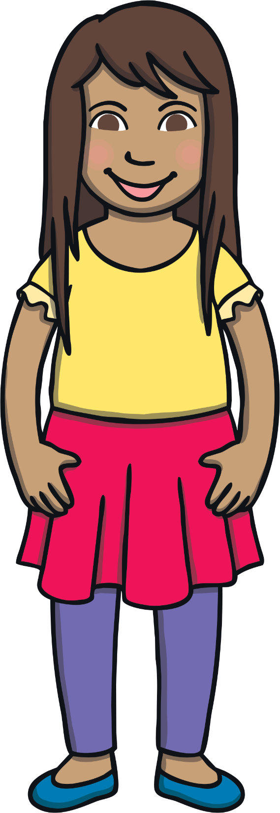
What Can I Do?
How you think about things can change how you feel.
However, it is also important to put energy into positive things that you can do to make things feel or become better. This is called positive action.
It is important to understand what is happening in your life and it is also
important to talk about anything that
you find difficult or worrying.

Slide 19
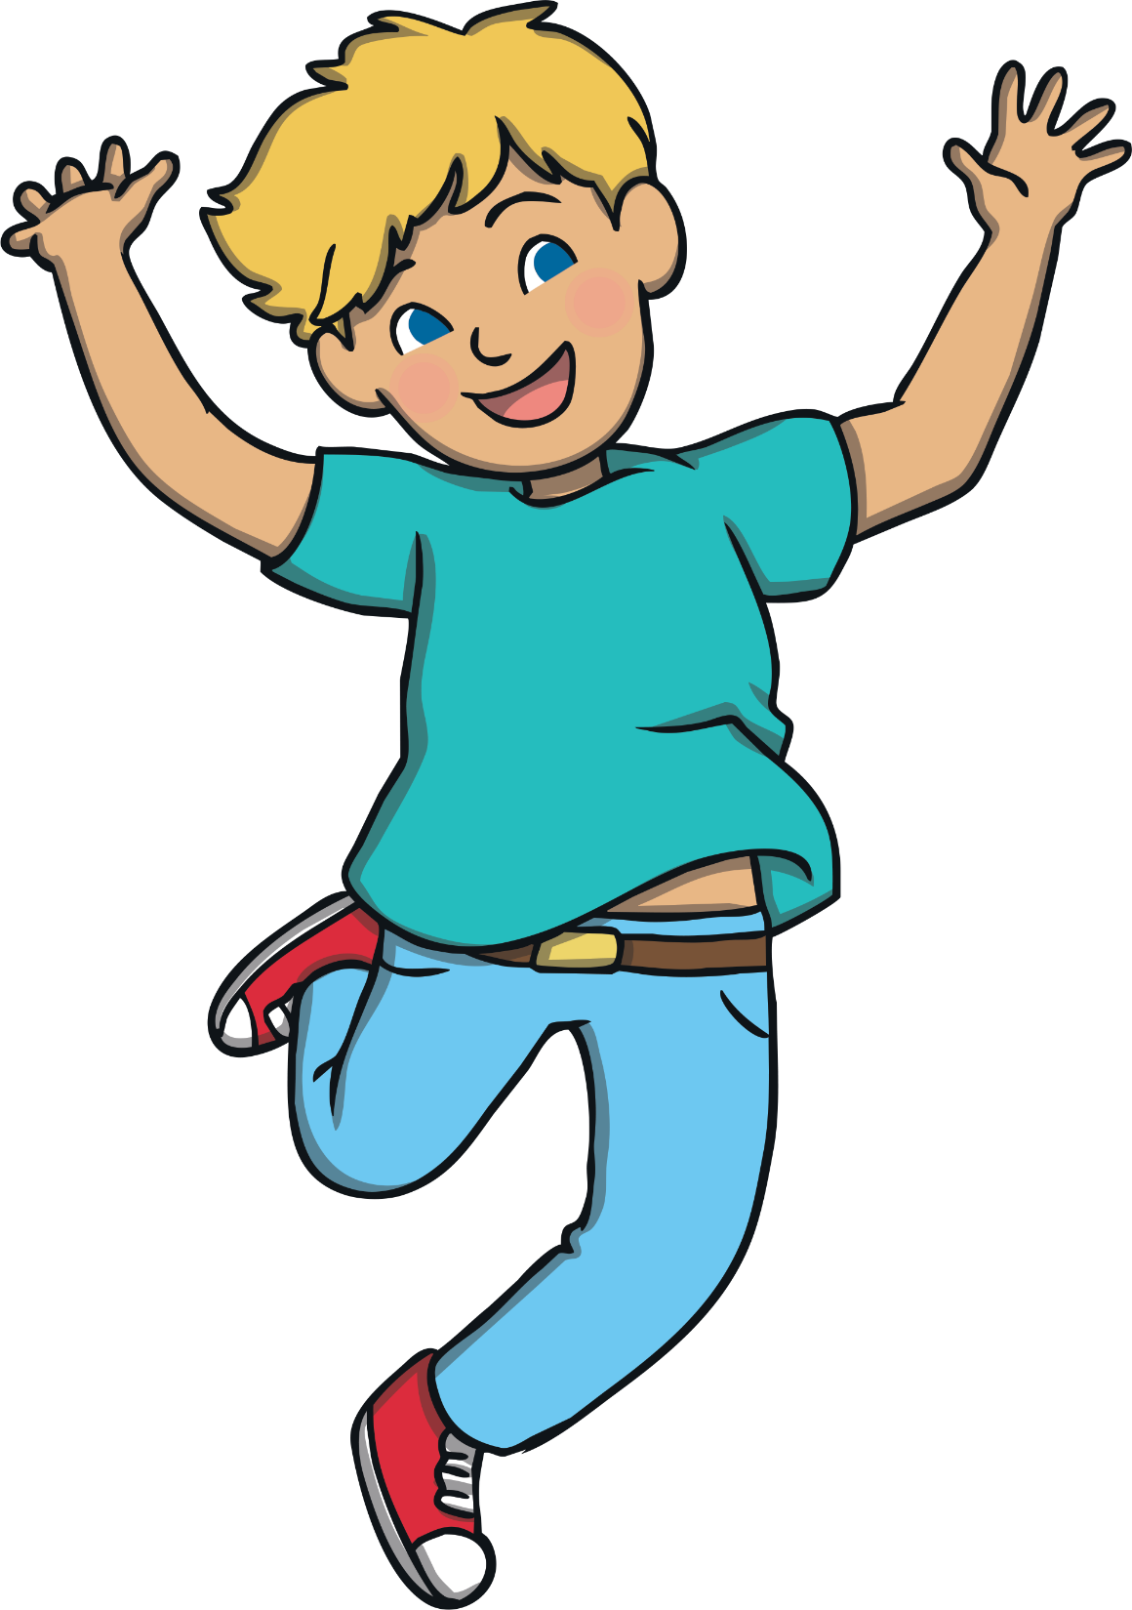
What Can I Do?
How you think about things can change how you feel.
Positive action does not mean ignoring the things that are not OK or pretending that everything is OK to try to ‘trick’ your mind.
Instead, positive action is doing something that makes you feel good and that can help with the stress or worry you are feeling.

Slide 20
What Can I Do?
For example, if someone is worried about crossing the road. They can think about positive actions. These include:
going to a zebra crossing
holding a
grown-up’s hand

Slide 21
What Can I Do?
crossing with a crossing patrol
being sensible when crossing
looking both ways

Slide 22
What Can I Do?
These positive actions can really help you to feel good and they can allow you to be in control of your stresses and worries.
These positive actions don’t stop the road being a worry but they do give you some control over feeling safer and more positive.

Slide 23
Uncomfortable Feelings
Feelings of stress and worry can make us feel uncomfortable. This can make us feel like we want to block the feelings, ignore them or hide them away.
We might notice that other people around us do this too.
It is really important that we all have someone we can talk to if we have difficult feelings or that we have ideas of what to do if we are feeling this way.
However, these feelings don’t just go away and they often come out in a different way. This might be through crying, feeling angry, being snappy or being very quiet.

Slide 24
Uncomfortable Feelings
Other ideas of ways to work through difficult feelings include:
writing them down

Slide 25
Uncomfortable Feelings
Other ideas of ways to work through difficult feelings include:
talking to
a friend

Slide 26
Uncomfortable Feelings
Other ideas of ways to work through difficult feelings include:
talking to
a trusted
family member

Slide 27
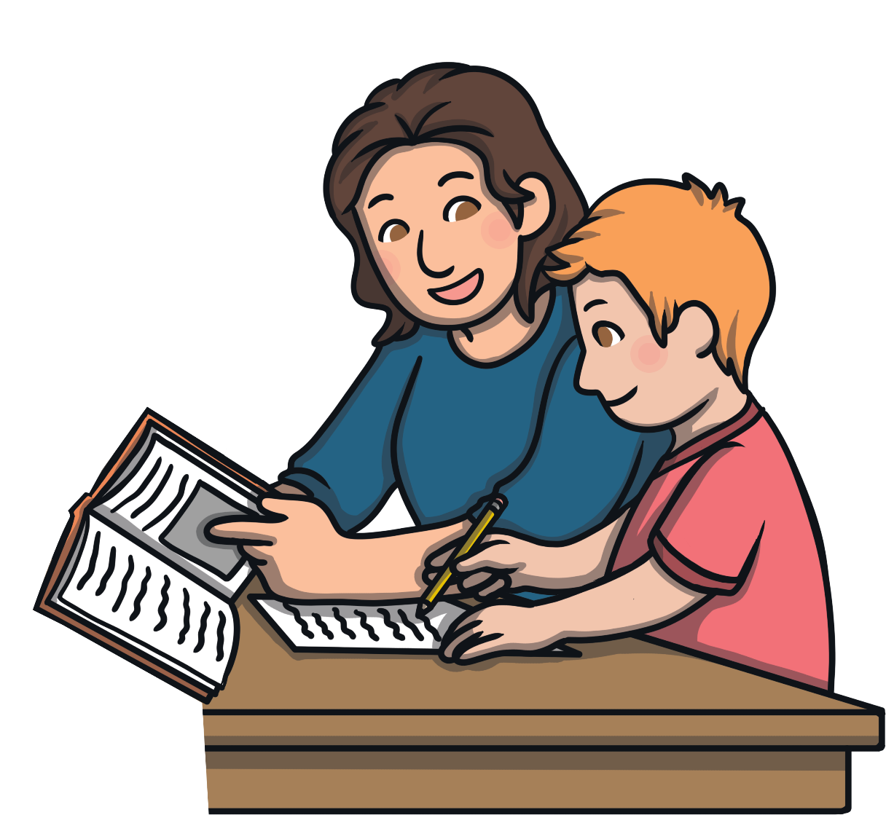
Uncomfortable Feelings
Other ideas of ways to work through difficult feelings include:
talking to
a trusted grown-up

Slide 28
Uncomfortable Feelings
Other ideas of ways to work through difficult feelings include:
doing some relaxation exercises, e.g. yoga

Slide 29

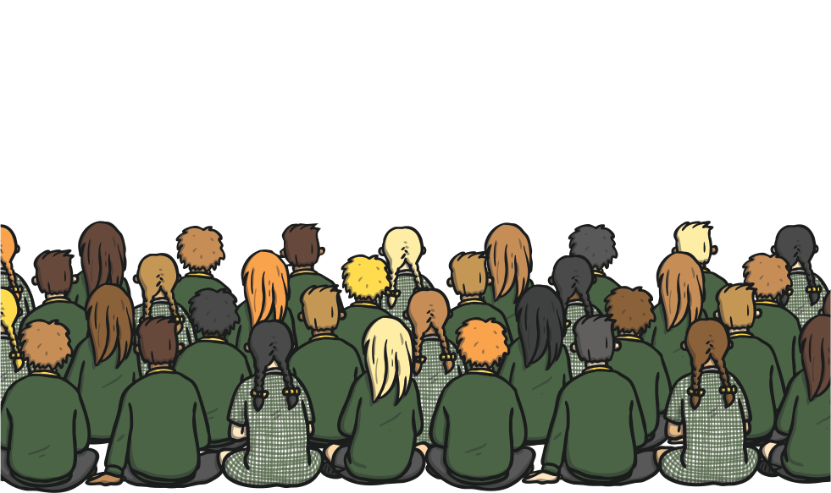
Why Do We Have
Stresses and Worries?
Lots of different things can make you feel stressed or worried.
This might be a feeling you have for a good reason, such as talking in your class assembly in front of the whole school.
Feeling stressed or worried at this time
is similar to having ‘butterflies in your tummy’ and the feeling can help give you extra energy to get the job done well.

Slide 30
Why Do We Have
Stresses and Worries?
However, not all stresses and worries are good. If your stress or worry is happening each day or is about something that leaves you feeling sad, then it can make you feel a bit unwell. This is what anxiety is.
You may also be having stresses or worries because you have too much happening in your life – being too busy can leave you feeling a bit unwell or ‘overwhelmed’. Even if all the things you are doing are fun things, it is important to have rest and relaxation time as well.
It is really important that we all have someone we can talk to if we have difficult feelings or that we have ideas of what to do if we are feeling this way.

Slide 31
Why Do We Have
Stresses and Worries?
However, not all stresses and worries are good. If your stress or worry is happening each day or is about something that leaves you feeling sad, then it can make you feel a bit unwell.
Knowing that this feeling is stress or worry can help you to begin to work through the feelings and get help with them.
If your stresses and worries are making you feel sad, it is important to talk to a grown-up you trust.

Slide 32






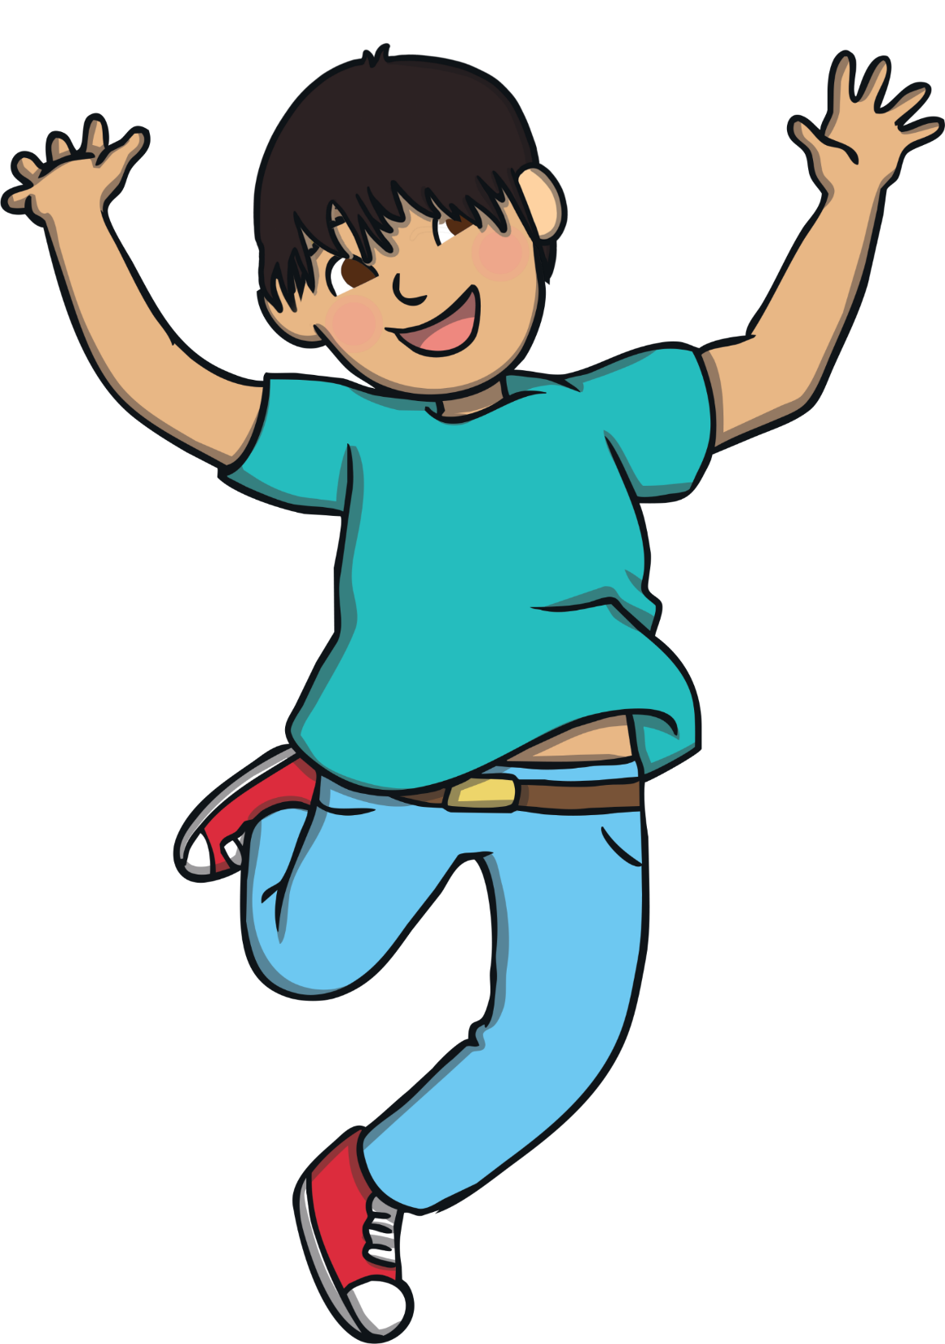
Spot the Positive
Look at this famous quote:
‘Life isn’t about waiting for the storm to pass. It’s about learning how to dance in the rain.’
(Vivian Greene)

Slide 33
Spot the Positive
Look at this famous quote:
This means that we don’t have
to pretend that everything is OK right now but that even when things aren’t OK, there will still be wonderful things within our life.
Even if those things are small, celebrating and focusing on them can really help you.

Slide 34
Spot the Positive
Look at the picture below:
In the picture, you will probably notice straight away that things don’t look too good. However, can you see anything
that is positive or good in the picture?
It might be something really big and obvious or it might be something very small that you could have easily missed.

Slide 35
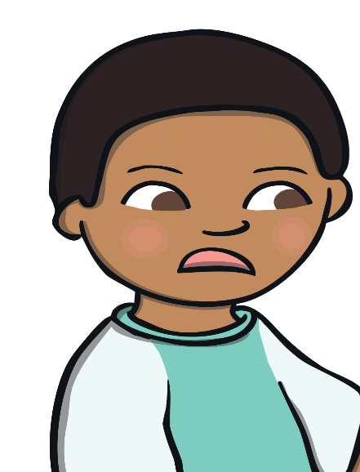



Being in Charge of
Your Emotions
In this image, Bobby is feeling worried as he has just broken his sister’s mirror.
He knows he needs to tell his sister but he wants to just hide away and pretend it hasn’t happened.
Instead, Bobby decides to be in charge of his emotions.
If he hides away, the worry of breaking the mirror would still be there.
Look on the next slide to see how Bobby was in charge of his emotions.

Slide 36
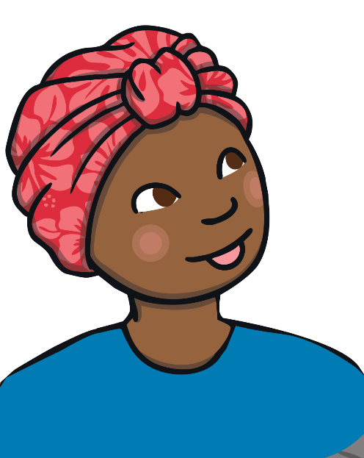
Being in Charge of
Your Emotions
In this image, Bobby is feeling worried as he has just broken his sister’s mirror.
He decides to talk to his mum first.
Bobby knows that he is worried and knows this is because he thinks his
sister might be upset or cross.
She goes with Bobby to help Bobby explain what has happened to his sister.
Bobby tells his mum what happened. His mum explains that how he responded was so sensible and honest and that she is proud of him.

Slide 37

Being in Charge of
Your Emotions
In this image, Bobby is feeling worried as he has just broken his sister’s mirror.
His sister understands and Bobby and his sister clear up the broken mirror together and then have a hug.
Being in charge of your emotions can help you to feel really good in all situations!

Slide 38


