Slide 1

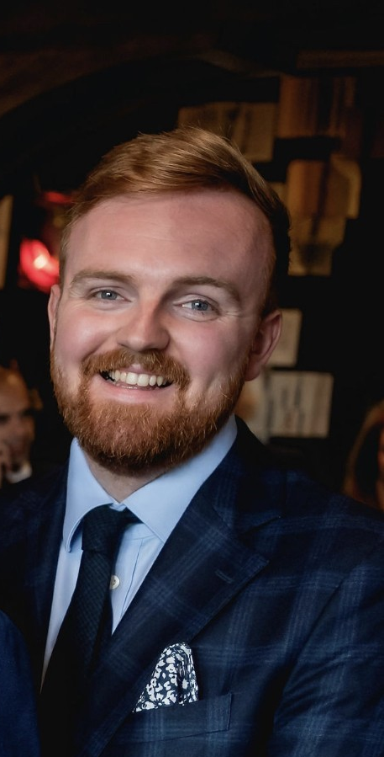
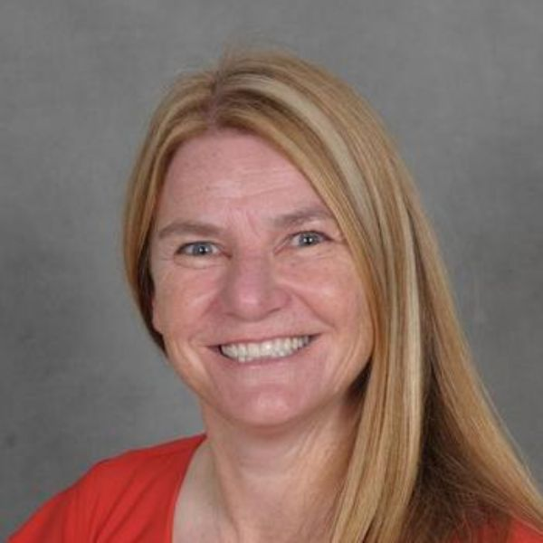
Welcome to Swans Class
Your teachers are…
Mr Lloyd
Mrs Mason
This information pack will give you information about Swans Class and answer any questions you may have.

Slide 2

Transition Days – New year 1 and 2 pupils.
Pupils have had a full day of transition. This was a great chance for pupils to get to know the classroom, teaching staff and each other.
Children completed a self portrait, wrote their name and completed some sentences.
Played some short games
Engaged with 2 stories – one they knew and one they didn’t.
Had PE with their new classmates to build relationships
Created their birthday cards for use throughout the year.

Slide 3
Transition in September
We will complete a range of transition activities in the first day or so to gently introduce your children back to school and to Swans Class where we will focus on settling children into school, building relationships and establishing class and school rules and expectations.
Year 1 will have access to provision and play up until at least October half term within the day.
Year 2 will move straight into the year 2 curriculum areas they need

Slide 4
On Your Child’s First Day
New year 1 and 2 pupils
What to wear ..
Full school uniform
Grey/black trousers or skirt
White shirt, t-shirt or blouse
Red sweatshirt or cardigan
Sensible black shoes
What to bring ..
A coat
Water bottle
Snack
Lunch box (if having a packed lunch)
A small bag to carry reading books and snacks. Spare clothes are not needed as we have a good selection of spares in school.

Slide 5

First Day in Swans/Yr2
School starts at 8:50 am
Children will line up outside (this will be a slight change for Recpetion children coming into year 1)
Children will walk into the school building, hang their coats up and walk into their classroom independently. A teacher will be around to guide the children and offer support where needed.
If you arrive after 8.50am please bring your child to the main reception, where they will be signed in.
School finishes at 3:20pm. Please collect your child from the playground. I will need to see you or the named person that is collecting your child before I let them leave the line. Please do not encourage them to run to you before I’ve let them go and made eye contact with the person collecting. Please note that the end of the day is very busy so we expect child to remain with their parents once dismissed.
If your child is going home with someone different then the school will need permission before we let them go.

Slide 6
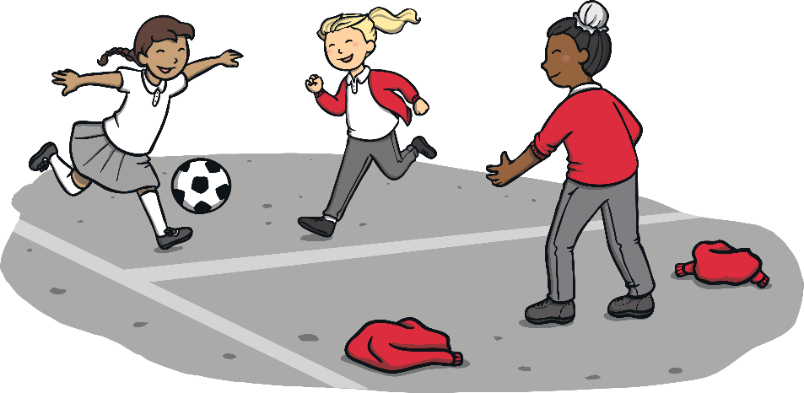
Breaktimes
The children have a morning break at 10:30am.
Pupils will need to bring their own bottles into school. Water is preferred but if your child really doesn’t like water then weak sugar free squash is allowed in a water bottle.
Snacks- we would encourage children to bring a healthy snack (fruit preferably) to eat during break time. Chocolate and/or crisps are not allowed and your child will be asked to keep these in their bag to take back home.
Please note we are a nut free school so children will not be allowed any foods containing nuts.
We also have an afternoon break in KS1 to separate the two afternoon lessons.
Please ensure your child has a waterproof coat with them throughout the autumn and winter months especially

Slide 7
Lunchtimes
Lunchtime for Swans will be – 12:00pm-1:00pm
All pupils in Swans class are entitled to a free school lunch that must be selected via Parent Pay pay.
Children will not be able to change their order once received by the kitchen.
Children may bring packed lunches if they wish however we would encourage pupils to try school dinners and would ask parents to speak to Swans staff if there are any concerns regarding school lunches. A lunch menu will be sent home termly.
Please note we are a nut free school so children will not be allowed any foods containing nuts.

Slide 8

Health
Staff need to be aware of your child’s medical background, in particular, any allergies (e.g. bee stings, dairy food), any dietary restrictions (e.g. vegetarian) and any medical conditions that are important for us to know (e.g. asthma or eczema).
It is imperative that all inhalers are kept in school and are up-to-date.
Children can suddenly become ill and therefore it is important that we know we can contact you or another adult/relative at all times. Please ensure that the school is kept up to date with your contact details. If your child is unable to attend school due to illness, please telephone the school office to let us know.

Slide 9

Reading
At school, your child will be given or will be able to choose a reading book from the school or class library system which they will take home daily. We ask that this book is returned each day to school.
Reading Record books will be sent home along with a reading book. Please ensure that each time your child reads, that the book is completed with a comment. When we listen to your child read in school we will also sign the book and add any relevant comments.
Books will be changed and reading recorded books signed weekly by staff.

Slide 10
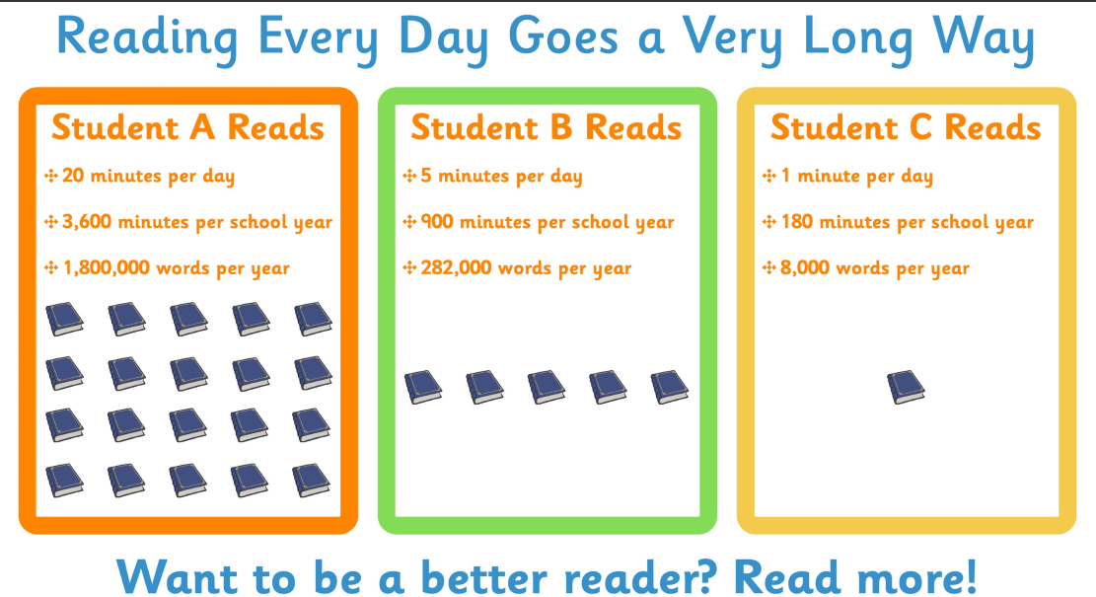
You can help support your child’s reading development by listening to them read, reading to them yourself and sharing a variety of books at home. We value your support and encourage you to contribute to your child’s reading diary.

Slide 11

Phonics
In phonics lessons children are taught three main things:
GPCs
They are taught GPCs. This stands for grapheme phoneme correspondences. This simply means that they are taught all the phonemes in the English language and ways of writing them down. These sounds are taught in a particular order. The first sounds to be taught are s, a, t, p.
Blending
Children are taught to be able to blend. This is when children say the sounds that make up a word and are able to merge the sounds together until they can hear what the word is. This skill is vital in learning to read.
Segmenting
Children are also taught to segment. This is the opposite of blending. Children are able to say a word and then break it up into the phonemes that make it up. This skill is vital in being able to spell words.
At Manor we follow the Little Wandle Phonics scheme

Slide 12
Writing
We focus heavily on narrative writing, spelling and basic sentence structures.
Yr 1 begin with dictated sentences and scaffolded work
Yr 2 will be writing in sentences from September with punctuation expected and conjunctions being used e.g. because.
Maths
7 areas:
Place Value
Addition and Subtraction
Multiplication and Division
Fractions
Measures
Geometry
Statistics

Slide 13
Topics Covered in Swans
There are daily maths and English lessons, often linked to the interesting and varied topic work we do.
We will aim to take Key Stage 1 children on a number of school trips linked to the curriculum. Keep your eyes on the newsletter and website for more information on these trips. Helpers are always welcome!
Long term plans for each subject can be found on the website (Learning -> curriculum -> History/science/geog etc)
Topics in September include ‘What is History’; ‘Habitats’ and ‘dynamics’
For more information on the national curriculum for key stage 1, please visit https://www.gov.uk/government/publications/national-curriculum-in-england-primary-curriculum or our school website.

Slide 14

PE
This year again we are asking that pupils come dressed in their PE kits on the days they have their PE lessons. Full details of our PE kit can be found on the school webpage.
If your child does not arrive in their kit then the pupil will need to borrow one of our spare kits or will miss their PE lesson for that week and will therefore need to complete a ‘PE Lesson’ crib sheet detailing the lesson that they have missed (in Swans class this will include a drawing of the activity and a ‘chat’ to the teacher about what the children were learning).
Please remove earrings on the day as we are not allowed to remove them. Long hair must be tied back.
Forest School – 9 weeks for year 1. Details and dates to follow.
Forest school items – trousers, long sleeved top, jumper, waterproof coat and trousers, wellington boots, hat, scarf and gloves)
Year 2 will remain in school working on Key Year 2 skills.

Slide 15

Homework
Weekly homework will consist of daily reading and learning spellings based on your children's phonics or spelling lessons from that week. Please practise them little and often. Spelling books will be sent home.
Spellings will be issued on a Friday with spelling books being sent home and tested the following Friday.
Additional Homework can be completed and bought in for Show and tell and will be rewarded but no expectation on Extra curricular homework
Please speak to myself, Mrs Mason or Mr Robson if there are any concerns regarding homework or if you need support.

Slide 16
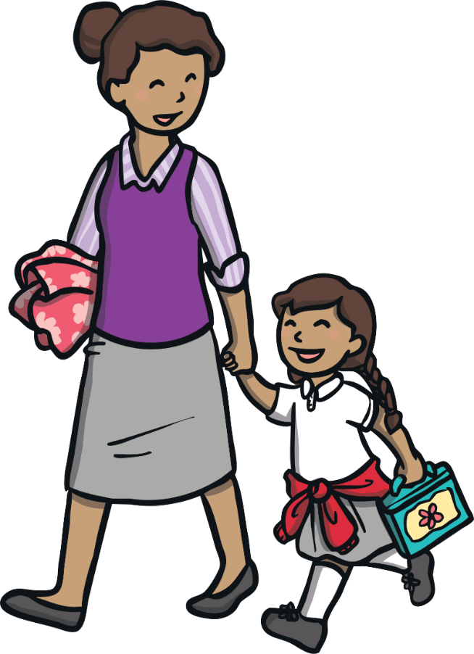
How Can You help?
We want to encourage our children to be as independent as possible. For example, we encourage them to be responsible for coming into school and putting their snack and water bottle away reading to begin their morning task.
Small school bags are permitted but spare clothes are unnecessary.
Read everything! Books are for enjoyment, as well as learning, so encourage reading as much as you can. Talk about what they’ve read, ask opinions, make predictions, visit the library and make sure your child sees you reading too.
Refer to the long-term plans for each subject and talk to your child about their learning. Perhaps arrange your own family trip or information gathering session, related to work done in class.
Support reading, spelling and homework, teach children to write their name in full with a capital letter, recognise coins and notes, begin to tell the time, counting, recognising numbers.

Slide 17
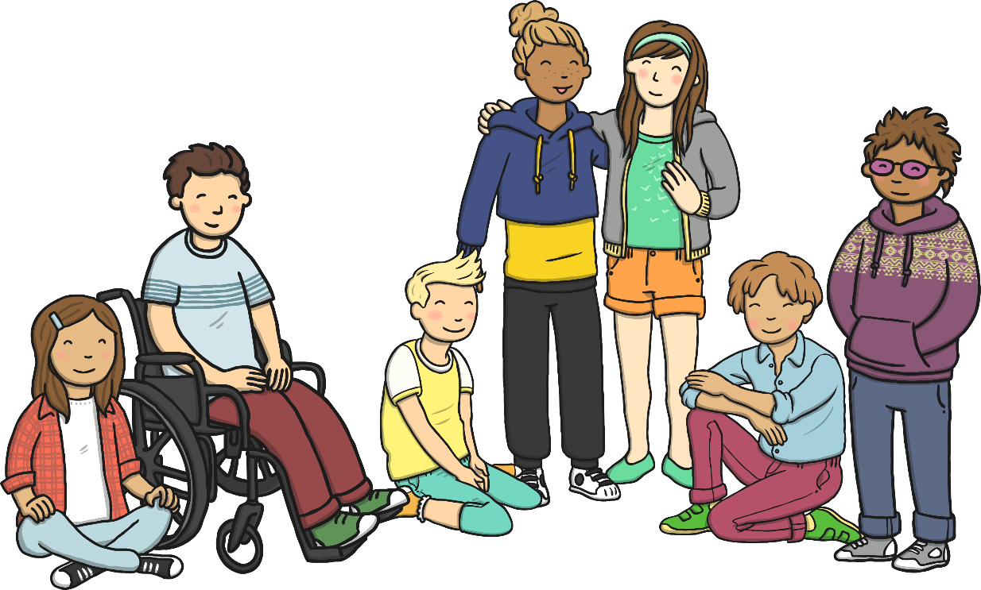
Any Questions?
We hope that this presentation is useful. Should you have any questions, please feel free to speak to a member of staff.
We aim to ensure that your children’s experience in Swans Class is a happy and rewarding one. We look forward to working with both you and your child/children.

