Slide 2
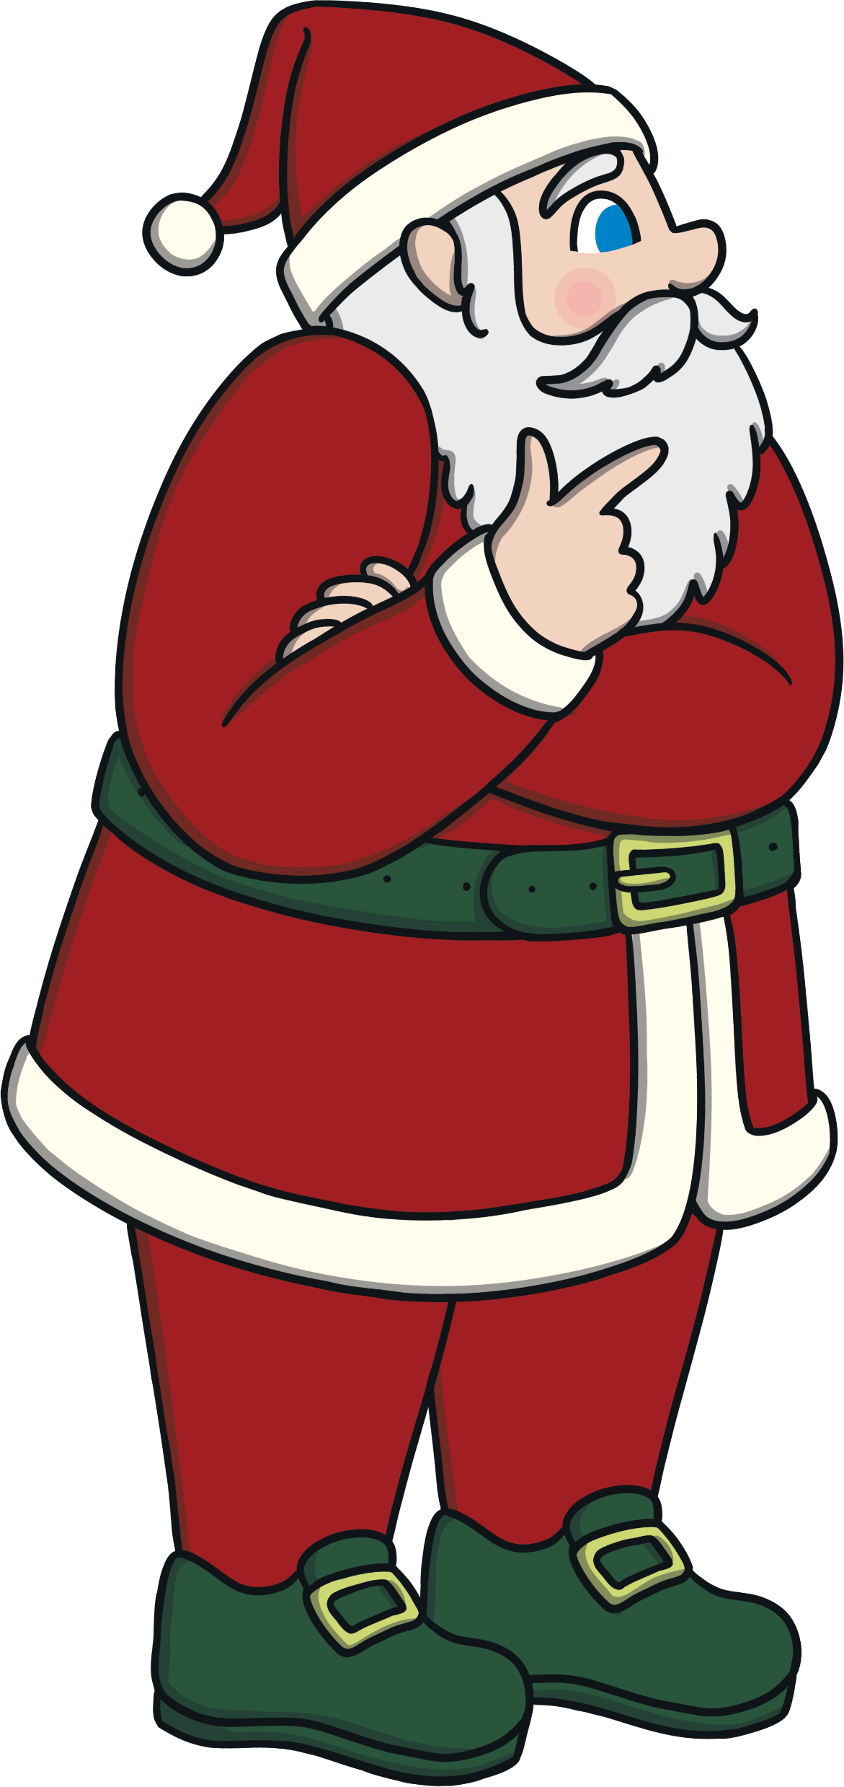
Song 1: A Christmas Quarrel
ELF & GROUP 1
& CHORUS:
The very best thing about Christmas,
Is presents under the tree,
Wrapped up in beautiful paper,
A magical mystery!
ELF & GROUP 2
& CHORUS:
No, the very best thing about Christmas,
As everybody knows,
Is building a great big snowman,
and sledging in the snow!
ALL:
Oh see, we can’t agree,
No matter how hard we’ve tried.
Our Christmas quarrel is spoiling things,
Oh, how will we decide?
ELF & GROUP 1
& CHORUS:
The very best thing about Christmas,
Is trimming up the tree,
With baubles, angels and tinsel,
It’s quite a sight to see!

Slide 3
Song 1: A Christmas Quarrel
ELF & GROUP 2
& CHORUS:
No, the very best thing about Christmas,
Is all the lovely food,
Mince pies, puddings and turkey,
Puts me in a Christmas mood!
ALL:
Oh see, we can’t agree,
No matter how hard we’ve tried.
Our Christmas quarrel is spoiling things,
Oh, how will we decide?

Slide 4
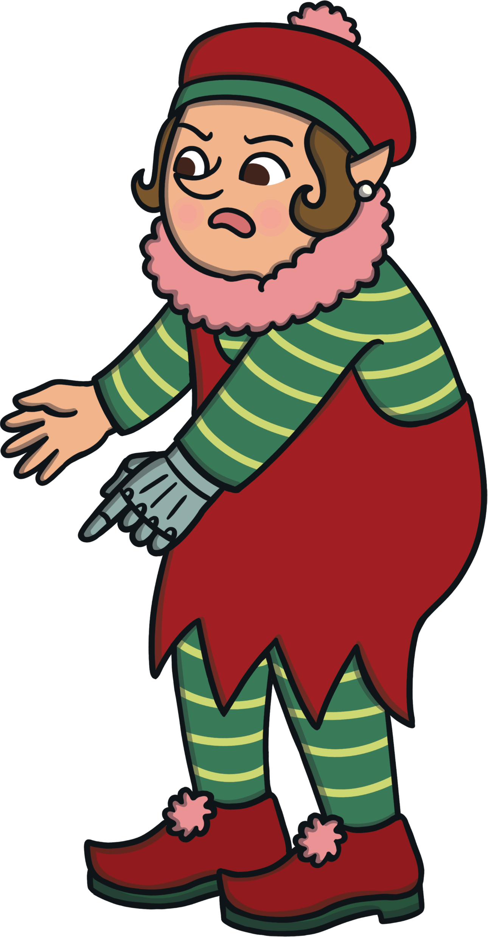
Song 2: Yule Log Burning
To the tune of ‘We Three Kings’
NORSE PEOPLE:
Dark and cold, our winter is grim,
Time to bring the light back in,
Ales and meats and tasty treats,
Now let the feast begin.
ALL:
Oh, Yule log burning, Yule log bright,
Darkness banished by your light,
Twelve nights blazing, it’s amazing,
Winter solstice starts tonight!
NORSE PEOPLE:
Evergreens will bring us bliss,
Decorate your houses with this,
Mistletoe will make the love grow,
And let us steal a kiss!
ALL:
Oh, Yule log burning, Yule log bright,
Darkness banished by your light,
Twelve nights blazing, it’s amazing,
Winter solstice starts tonight!

Slide 5
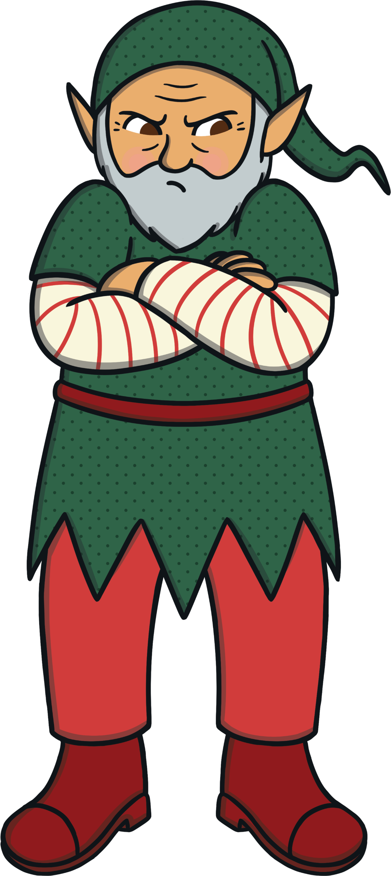
Song 3: Bangs of Expectation!
To the tune of ‘Deck the Halls’
ALL:
Tom has got a new creation,
Fa la la la la la la la la!
It will be a huge sensation,
Fa la la la la la la la la!
Place the toys in coloured wrapping,
Fa la la la la la la la la!
Add a strip to make the snapping,
Fa la la la la la la la la!

Slide 6
Song 3: Bangs of Expectation!
ALL:
Bonbons were the inspiration,
Fa la la la la la la la la!
Fire sparked a revelation,
Fa la la la la la la la la!
When you give a pulling motion,
Fa la la la la la la la la!
There will be a great explosion,
Fa la la la la la la la la!
ALL:
Add a joke that’s really crummy,
Fa la la la la la la la la!
One that really isn’t funny,
Fa la la la la la la la la!

Slide 7
Song 3: Bangs of Expectation!
ALL:
Crackers help our celebration,
Fa la la la la la la la la!
Here’s to ‘Bangs of Expectation!’
Fa la la la la la la la la!

Slide 8
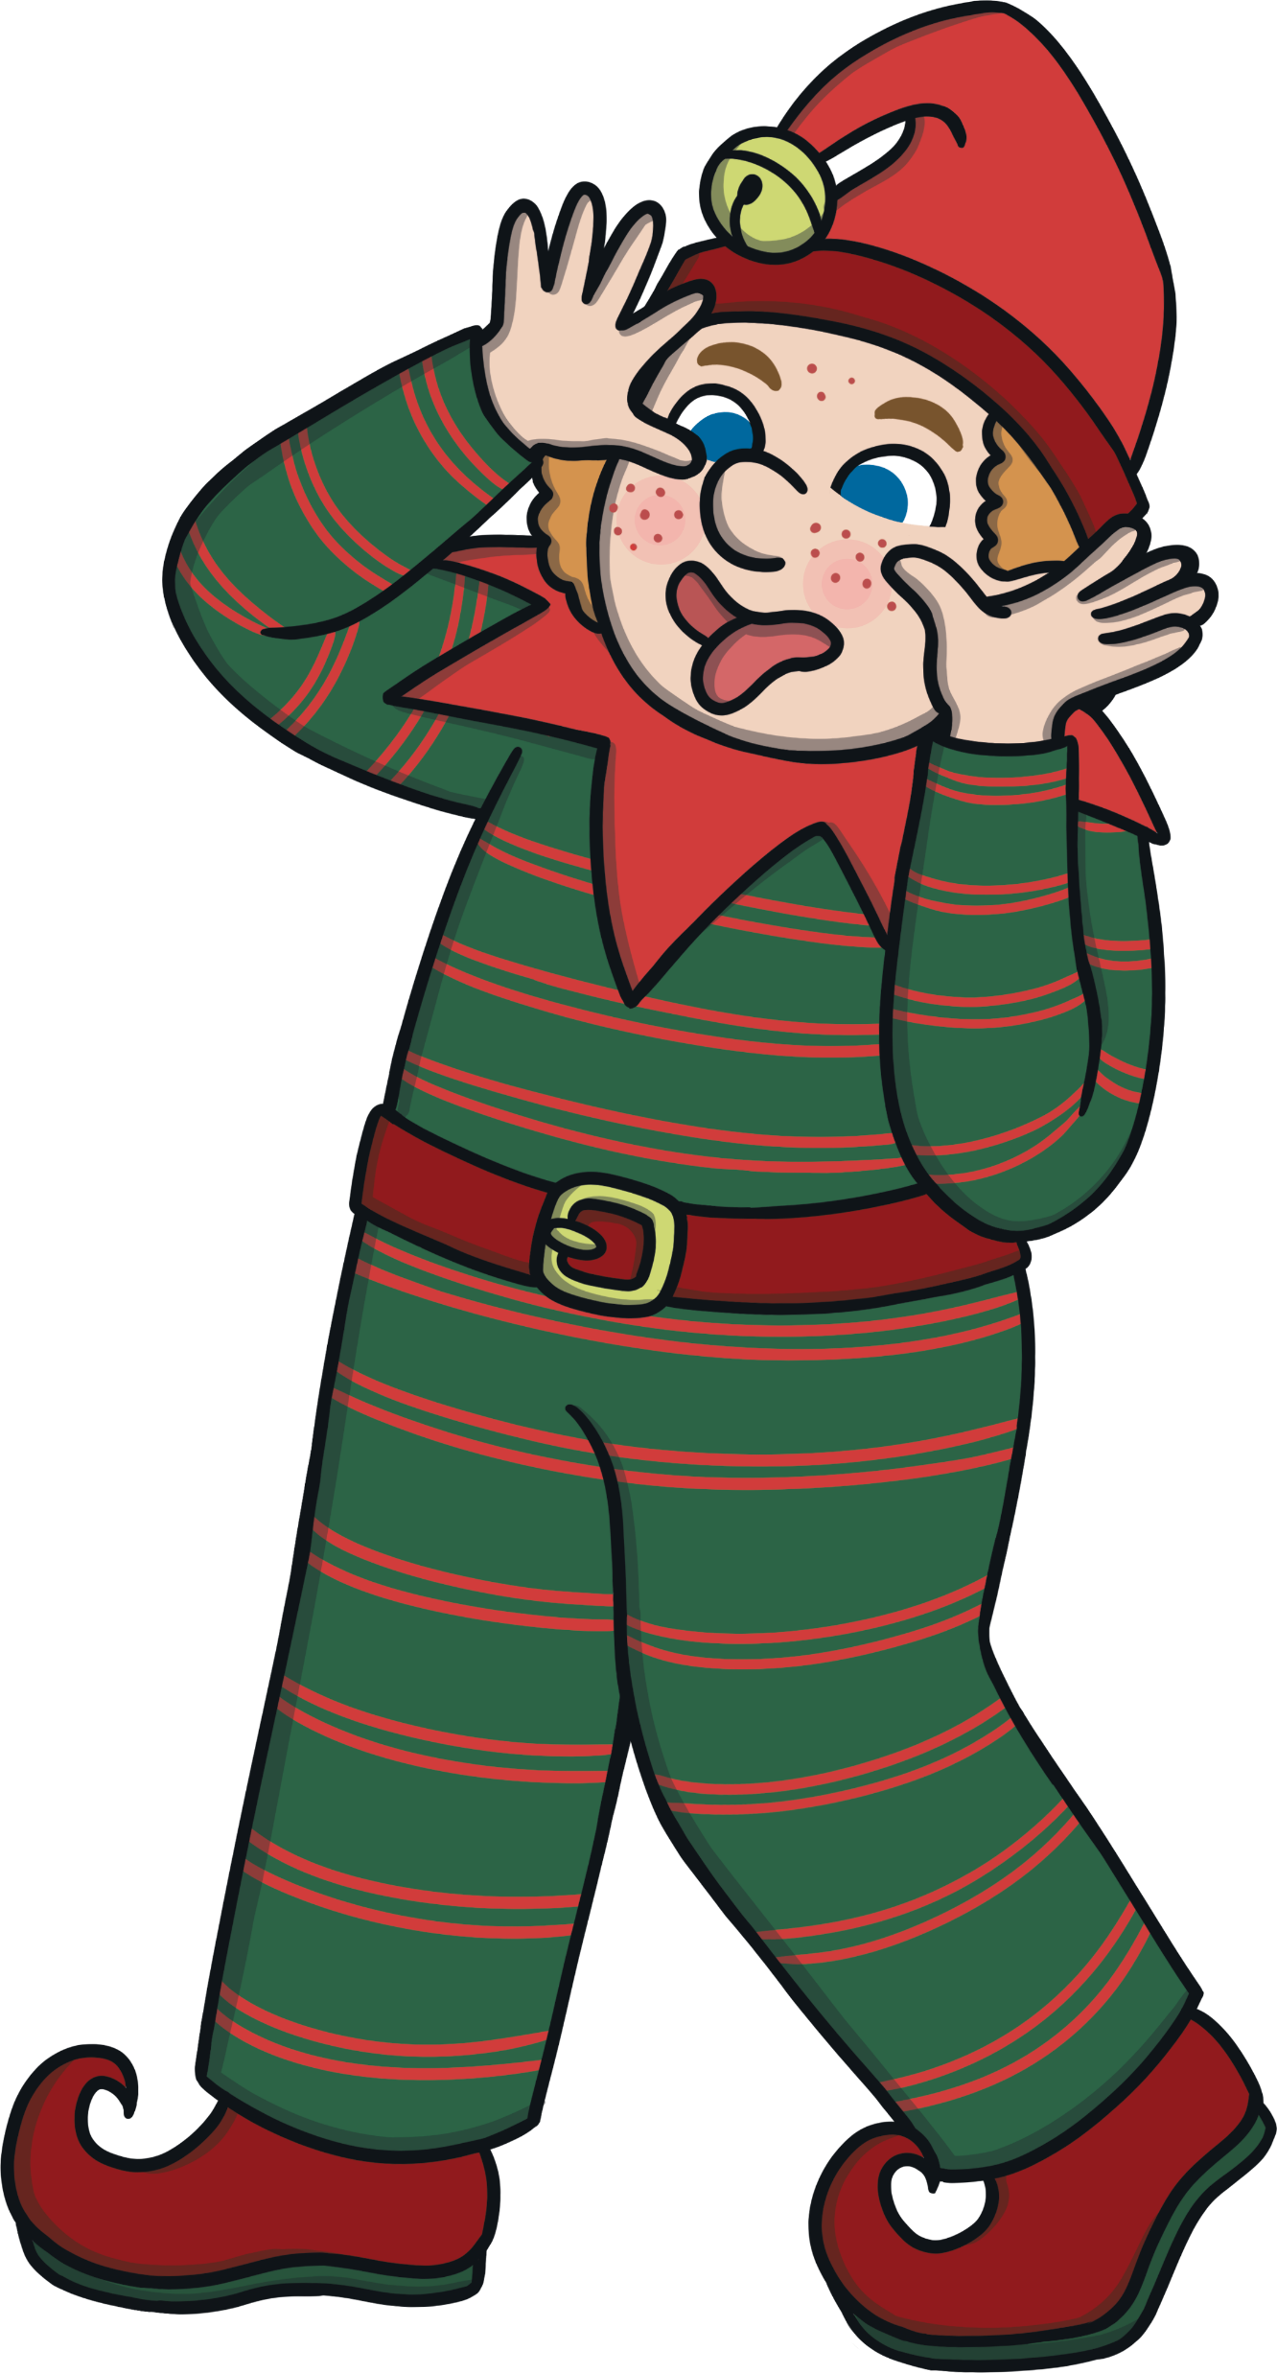
Song 4: We Decorate our Christmas Tree
To the tune of ‘I Saw Three Ships’
ALL:
We decorate our Christmas tree,
For Christmas Day, for Christmas Day,
It’s such a lovely sight to see,
For Christmas Day in the morning.
MISS BERRY & CHILDREN:
We wrap the tinsel round and round,
Our Christmas tree, our Christmas tree,
From way up high down to the ground,
For Christmas Day in the morning.
MISS BERRY & CHILDREN:
We hang the baubles on the tree,
For Christmas Day, for Christmas Day,
Or pickles if you’re from Germany,
For Christmas Day in the morning.

Slide 9
Song 4: We Decorate our Christmas Tree
ALL:
We decorate our Christmas tree,
For Christmas Day, for Christmas Day,
It’s such a lovely sight to see,
For Christmas Day in the morning.
MISS BERRY & CHILDREN:
Our fairy lights will twinkle round,
Our Christmas tree, our Christmas tree,
On top is where the Angel’s found,
For Christmas Day in the morning.
MISS BERRY & CHILDREN:
A sparkly spider adds some bling,
To our Christmas tree, our Christmas tree,
With painted popcorn on a string,
For Christmas Day in the morning.
ALL:
We decorate our Christmas tree,
For Christmas Day, for Christmas Day,
It’s such a lovely sight to see,
For Christmas Day in the morning.

Slide 10
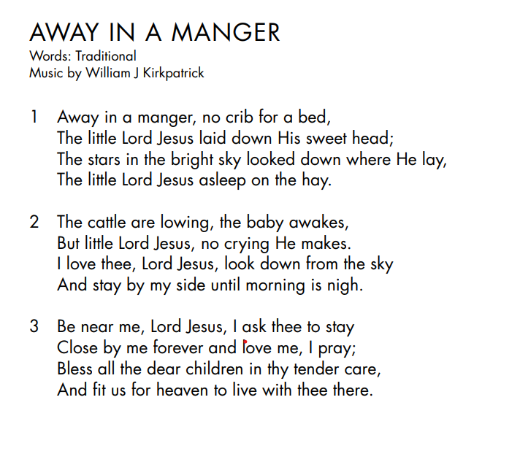
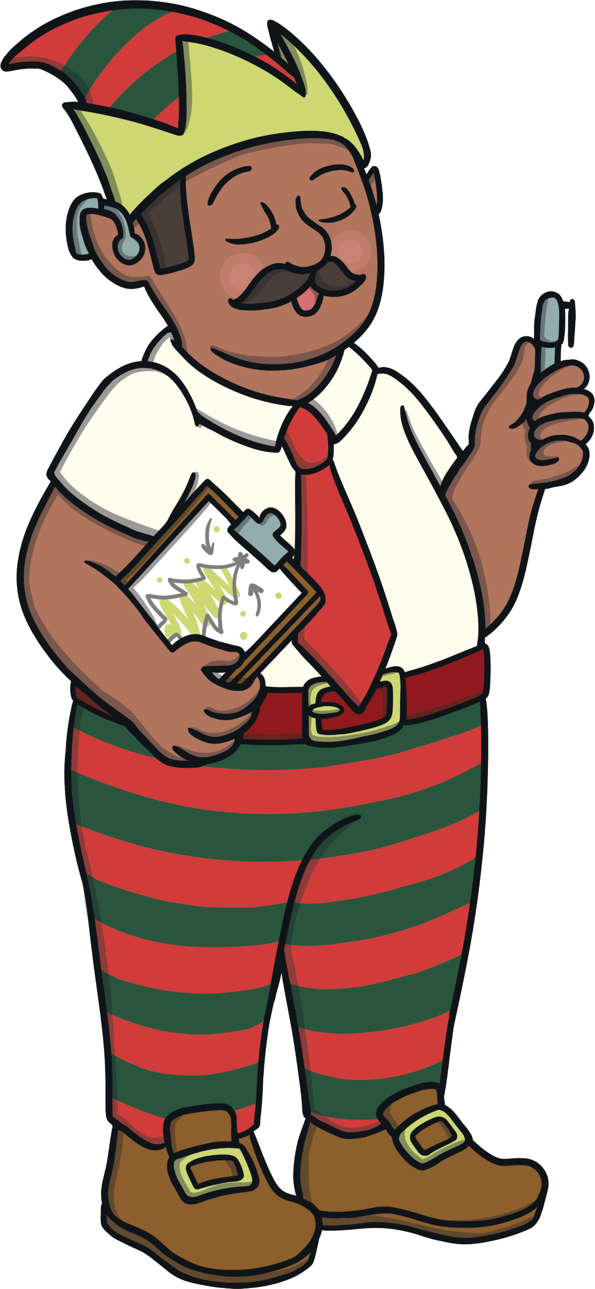
Song 5: Away in a Manger
Use Out of the Ark for music

Slide 11
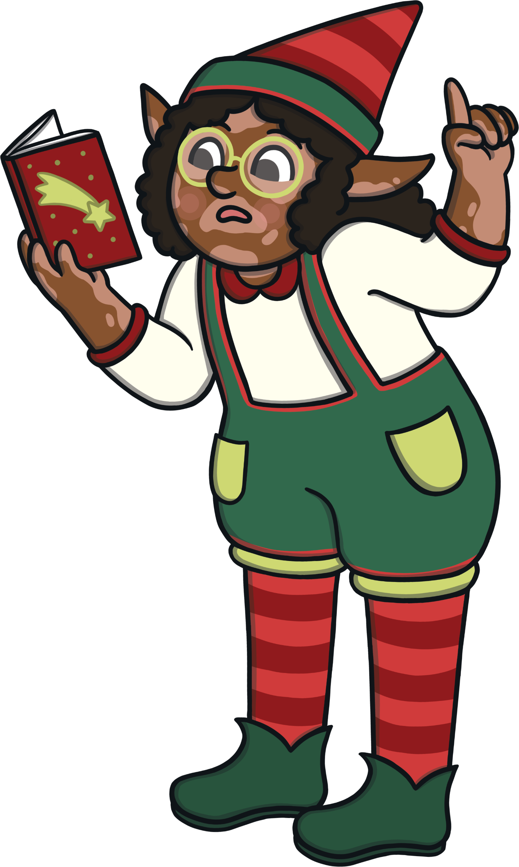
Song 6: Wrap and Stack
To the tune of ‘Jingle Bells’
ELF GROUP 1
& CHORUS:
We’ve been working hard,
To build all of the toys,
Making presents for,
All the girls and boys.
SANTA and Yr 2 ELVES :
This car has no wheels,
Now it’s no time to shirk,
This teddies head is back to front,
Let’s get back to work!
ALL:
Oh! Wrap and stack, wrap and stack,
Tie it with a bow,
Place it neatly on the sleigh,
And try not to be slow! Hey!

Slide 12
Song 6: Wrap and Stack
ALL:
Wrap and stack, wrap and stack,
Tie it with a bow,
Place it neatly on the sleigh,
It's nearly time to go!
ELF GROUP 2
& CHORUS:
Thomas wants a ball,
Jenny wants a train,
Dad is hoping for some cash,
But no, it's socks again!
Grandma wants a bag,
With matching hat and coat,
Grandpa needs a hearing aid,
He thought she said, ‘a goat!’

Slide 13
Song 6: Wrap and Stack
ALL:
Oh! Wrap and stack, wrap and stack,
Tie it with a bow,
Place it neatly on the sleigh,
And try not to be slow! Hey!
Wrap and stack, wrap and stack,
Tie it with a bow,
Place it neatly on the sleigh,
It’s nearly time to go!
Place it neatly on the sleigh,
It’s really time to go – hey!

Slide 14
Song 7: In Our House at Christmas
To the tune of ‘The Twelve Days of Christmas’
Insert your children’s favourite memories and traditions on the underlined lines. You may wish to allocate lines to groups or individuals depending on how you stage this.
In our house at Christmas, our family will be,
Hanging baubles onto our tree.
In our house at Christmas, our family will be,
Playing lots of games,
And hanging baubles onto our tree.
In our house at Christmas, our family will be,
Watching Christmas films,
Playing lots of games,
And hanging baubles onto our tree.

Slide 15
Song 7: In Our House at Christmas
In our house at Christmas, our family will be,
Making snow angels
Watching Christmas films,
Playing lots of games,
And hanging baubles onto our tree.
...and so on until:
In our house at Christmas, our family will be,
Writing to Santa,
Leaving Rudolph carrots,
Visiting Grandma,
Making Christmas boxes,
Dancing the conga,
Singing silly songs,
Wearing Christmas jumpers,

Slide 16
Song 7: In Our House at Christmas
Christmas Elf,
Making snow angels,
Watching Christmas films,
Playing lots of games,
And hanging baubles onto our tree.

Slide 17
Song 8: The Best Design
To the tune of ‘Jingle Bells’
ALL:
The very best thing about Christmas,
Was so hard to decide,
Everyone had their own favourite,
And wanted you to take their side.
ALL:
But the very best thing about Christmas,
Is really very clear,
It’s love, hope and understanding,
And spreading Christmas cheer.
ALL:
Now see, we all agree,
That Christmas is a time,
To spend with friends and family,
Now that’s the best design!
ALL:
We hope you enjoyed our journey,
A fun trip through history,
Of Yule logs, crackers and presents,
And decorations for the tree.

Slide 18
Song 8: The Best Design
ALL:
And now that it's nearly Christmas,
There’s only one thing to do,
To wish you a merry Christmas,
And a very happy new year too!
ALL:
Now see, we all agree,
That Christmas is a time,
To spend with friends and family,
Now that’s the best design!
Yes, now see, we all agree,
That Christmas is a time,
To spend with friends and family,
Now that’s the best design!
MERRY CHRISTMAS EVERYONE!

