Slide 1

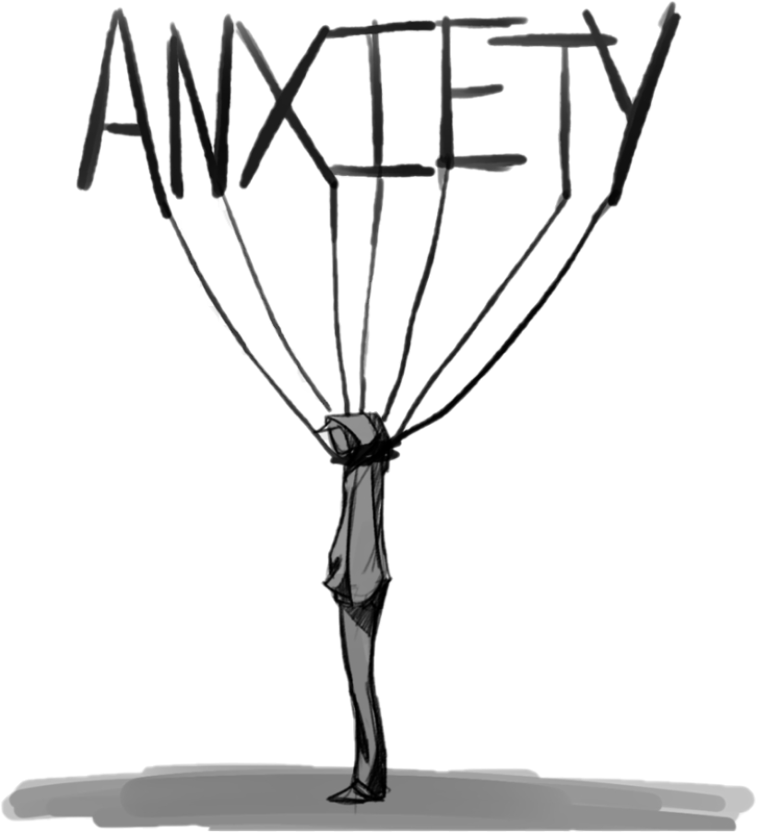
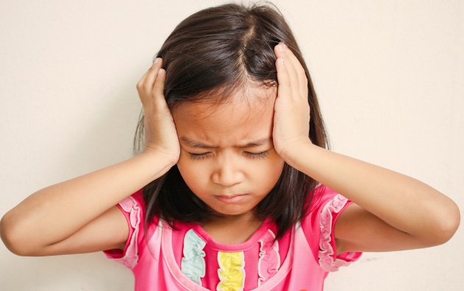
Introduction to Anxiety

Slide 2
Objectives
To learn about the signs, symptoms and causes of anxiety
To introduce a CBT model
To find out how to support as a parent/carer
To explore a range of NHS approved apps and resources

Slide 3
What is anxiety?
https://www.youtube.com/watch?v=rpolpKTWrp4
Anxiety is a normal and useful emotion. It alerts us to and helps us cope with difficult, challenging or dangerous situations
Anxiety is very common.
Anxiety becomes a serious problem when it stops you or your child from enjoying normal life. This is when anxiety has taken over and you have lost control. At this point, it is likely that an individual would be suffering from Anxiety Disorder as opposed to generalised anxiety.
Cathy Creswell: Helping your child with fears and worries
Overestimation of threat + Underestimation of ability to cope = Anxiety
Notes:
https://www.youtube.com/watch?v=rpolpKTWrp4

Slide 4
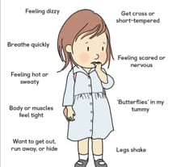
Responses to anxiety – Body responses
from Anxiety by Paul Stallard published by Routledge
Every human being is born with the ability to recognise a small set of emotions, and anxiety is one of them.
Anxiety is a response to the hormone adrenaline. It is completely normal, and indeed it is essential for survival.
The surge of adrenaline through the body promotes the FIGHT, FLIGHT or FREEZE response in preparation for imminent danger.

Slide 5
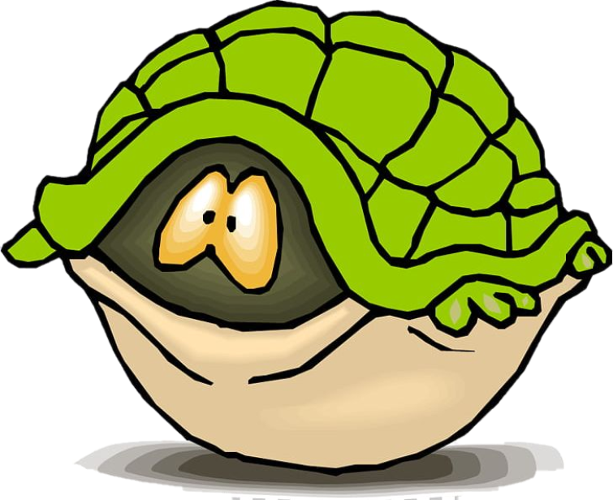
Responses to anxiety – other responses
Alongside changes to the body, other symptoms of anxiety include:
  Palpitations
  Headache, tingling and numbness
  Choking feelings, dry mouth
  Vomiting, urinary frequency, diarrhoea
  Unrealistic and / or excessive fear and worry about past and future events
  Avoidance of situations
These changes in response to anxiety may be helpful in the short term but if they continue after the danger has passed, or when there was never any real danger there, this can become problematic.
Cathy Creswell: Helping your child with fears and worries

Slide 6
Situation: Where were you? Who were you with? What happened to trigger the problem?
Thoughts
What thoughts went through your head?
Behaviours
What did you do?
Emotions
What were you feeling?
Physical symptoms
What happened in your body?

Slide 7
Situation: At school, teacher asked me a question I did not know the answer to
Thoughts
I won't be able to get the answer right
I can't do it
Everyone will laugh at me
Behaviour
Keep quiet
Avoid that lesson
Emotions
Nervous
Embarrassed
Worried
Physical symptoms
Sweaty
Shaky
Feel sick

Slide 8
Situation: At school, teacher asked me a question I did not know the answer to
The CBT model tells us that in order to break this cycle of anxiety, we need to change our behaviour and/or challenge our thoughts
Thoughts
I won't be able to get the answer right
I can't do it
Everyone will laugh at me
Behaviour
Keep quiet
Avoid that lesson
Emotions
Nervous
Embarrassed
Worried
Physical symptoms
Sweaty
Shaky
Feel sick

Slide 9
A simple CBT model
Situation: At school, teacher asked me a question I did not know the answer to
The CBT model tells us that in order to break this cycle of anxiety, we need to change our behaviour and/or challenge our thoughts
Thoughts
I might get the answer right
I can do it
My friends are supportive and won’t laugh at me
Behaviour
Speak up
Join in with the lesson
Give it a try
Emotions
Nervous
Embarrassed
Worried
Physical symptoms
Sweaty
Shaky
Feel sick

Slide 10
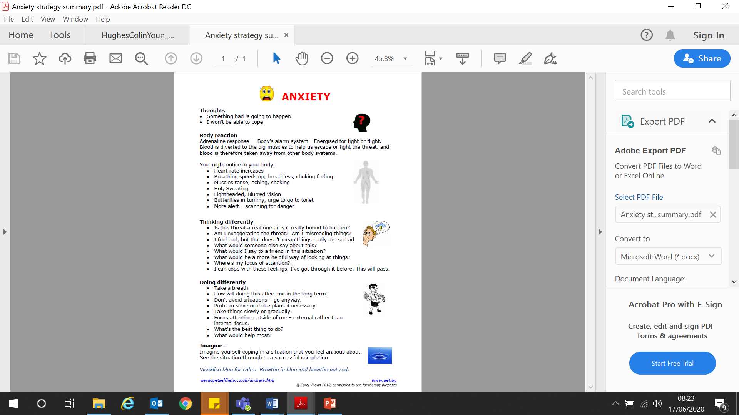
Thinking differently, doing differently
www.getselfhelp.co.uk/anxiety.htm

Slide 11
Your thoughts are not you
Is my thought FACT or OPINION?
What would I say to a friend in this situation?
Am I jumping to conclusions?
https://www.youtube.com/watch?time_continue=221&v=0QXmmP4psbA&feature=emb_logo
https://www.youtube.com/watch?time_continue=221&v=0QXmmP4psbA&feature=emb_logo ​
Notes:
Watch video https://www.youtube.com/watch?time_continue=221&v=0QXmmP4psbA&feature=emb_logo

Slide 12
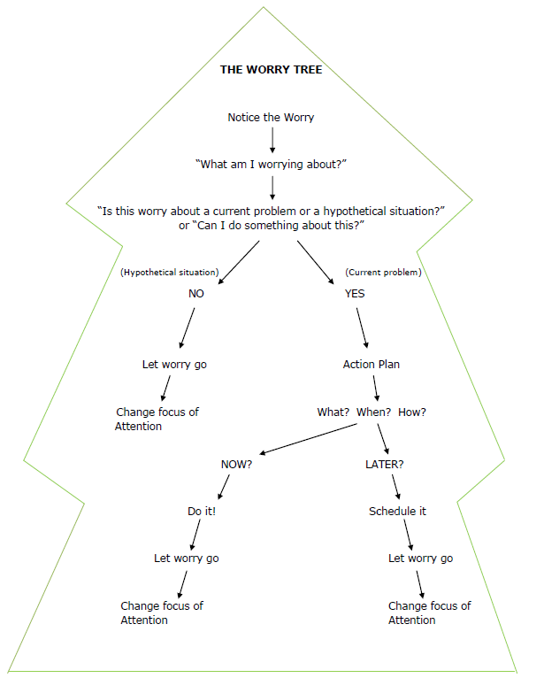
Worry tree
Can I deal with this worry?
Yes = problem solve it
No = let it go, refocus attention
Cognitive Behavioural Therapy (CBT) Skills Workbook. Hertfordshire Partnership

Slide 13
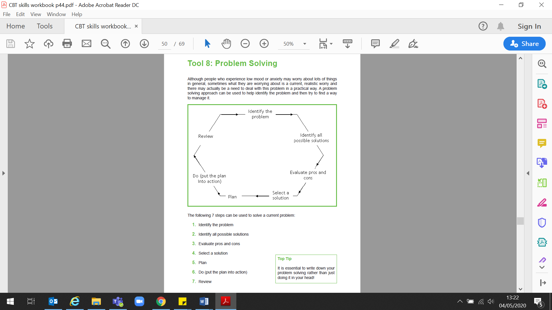
Problem solving
Cognitive Behavioural Therapy (CBT) Skills Workbook. Hertfordshire Partnership

Slide 14
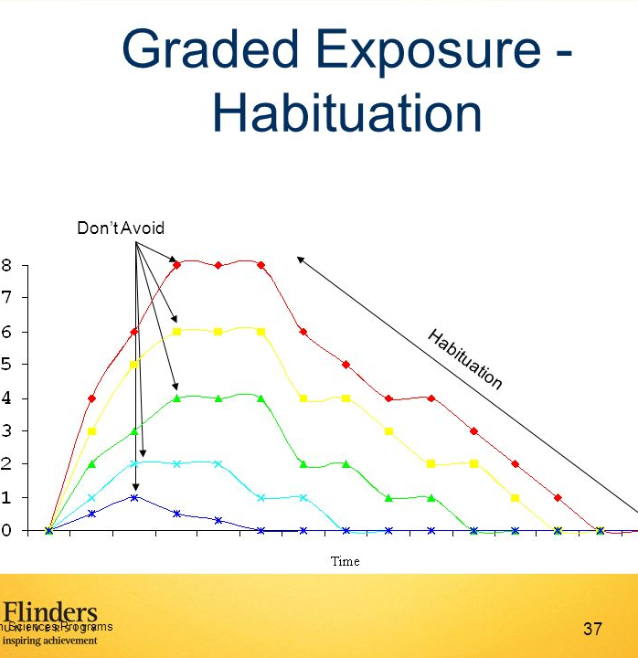
Riding the wave
The anxious response only lasts for a limited time
After that, even if we're still near the "scary thing" our body won't react, and we can become used to it.
If we can ride that wave of anxiety, it will pass. Our bodies learn that the stimulus isn't dangerous, and that panicked or anxious response will become less strong each time, until it isn't there at all!
Avoidance of situations which cause us worry means that we will not learn to confront the emotions connected with the anxiety, and so the anxiety will not be reduced.

Slide 15
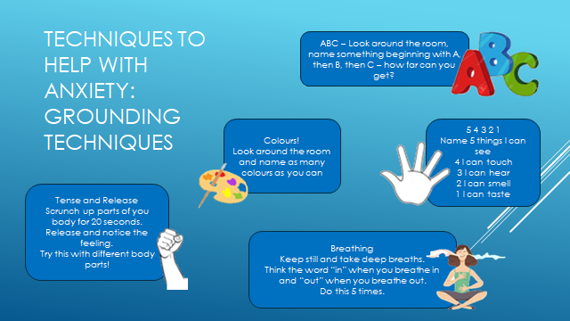
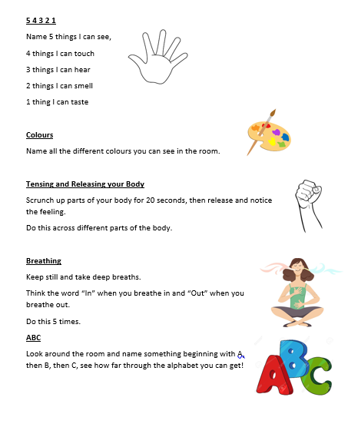
Techniques to help with anxiety: Grounding techniques

Slide 16
Techniques to help with anxiety: Progressive muscle relaxation
Progressive Muscle Relaxation is an exercise that reduces stress and anxiety in the body.
Slowly tense, and then relax each muscle.
This can provide an immediate feeling of relaxation, and its best to practice this frequently.
https://www.therapistaid.com/worksheets/progressive-muscle-relaxation-script.pdf

Slide 17

How to support your child with anxiety
S – Show your child how to be successful
U – Understand that your child has a problem
P – Patient approach
P – Prompt new skills
O – Observe your child
R – Reward and praise their efforts
T – Talk about it
from Anxiety by Paul Stallard published by Routledge

Slide 18
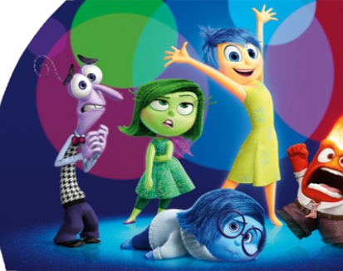
Facilitating conversation between you and your child
Some children may find it difficult to open up about how they are feeling or may lack the vocabulary to express themselves.
Disney's 'Inside Out’ can help to understand different emotions and may be a useful way to discuss how your child is feeling: ’Which character are you right now?'
https://www.bing.com/videos/search?q=inside+out+anxiety&ru=%2fvideos%2fsearch%3fq%3dinside%2bout%2banxiety%26FORM%3dHDRSC4&view=detail&mid=E54349E2DF76D4FA5249E54349E2DF76D4FA5249&&FORM=VDRVRV
Notes:
If your child is young…

Slide 19
Videos we like
Huge bag of worries book for children
https://www.youtube.com/watch?v=NbcswBYnmeQ
Anxiety explained for children
https://www.youtube.com/watch?v=FfSbWc3O_5M
Anxiety explained for teens
https://www.youtube.com/watch?v=rpolpKTWrp4
Cycle of avoidance within anxiety (teens)
https://www.youtube.com/watch?v=-CAd9o9OlqM
Managing anxiety
https://www.youtube.com/watch?v=7WtdmJi76mU

Slide 20
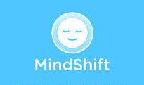

Apps that can help with anxiety
Mind Shift
Teaches about anxiety, helping users to engage in healthy thinking and to take action. Users check in each day to track their anxiety and work with tools in the app
Calm Harm
Provides tasks to help you resist or manage the urge to self-harm. You will be able to track your progress and notice change.

Slide 21

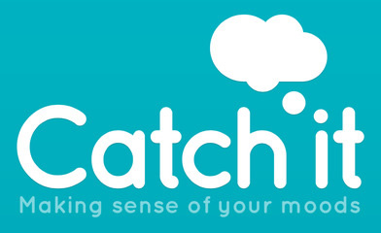
Apps that can help with anxiety
Headspace
Learn to manage feelings and thoughts with the lifelong skill of everyday mindfulness, any time of the day.
Catch it
Uses Cognitive Behavioural Therapy style approaches to help users learn how to manage feelings like anxiety and depression. Users can record and rate their mood, helping them to keep track of progress and identify triggers to their symptoms.

Slide 22

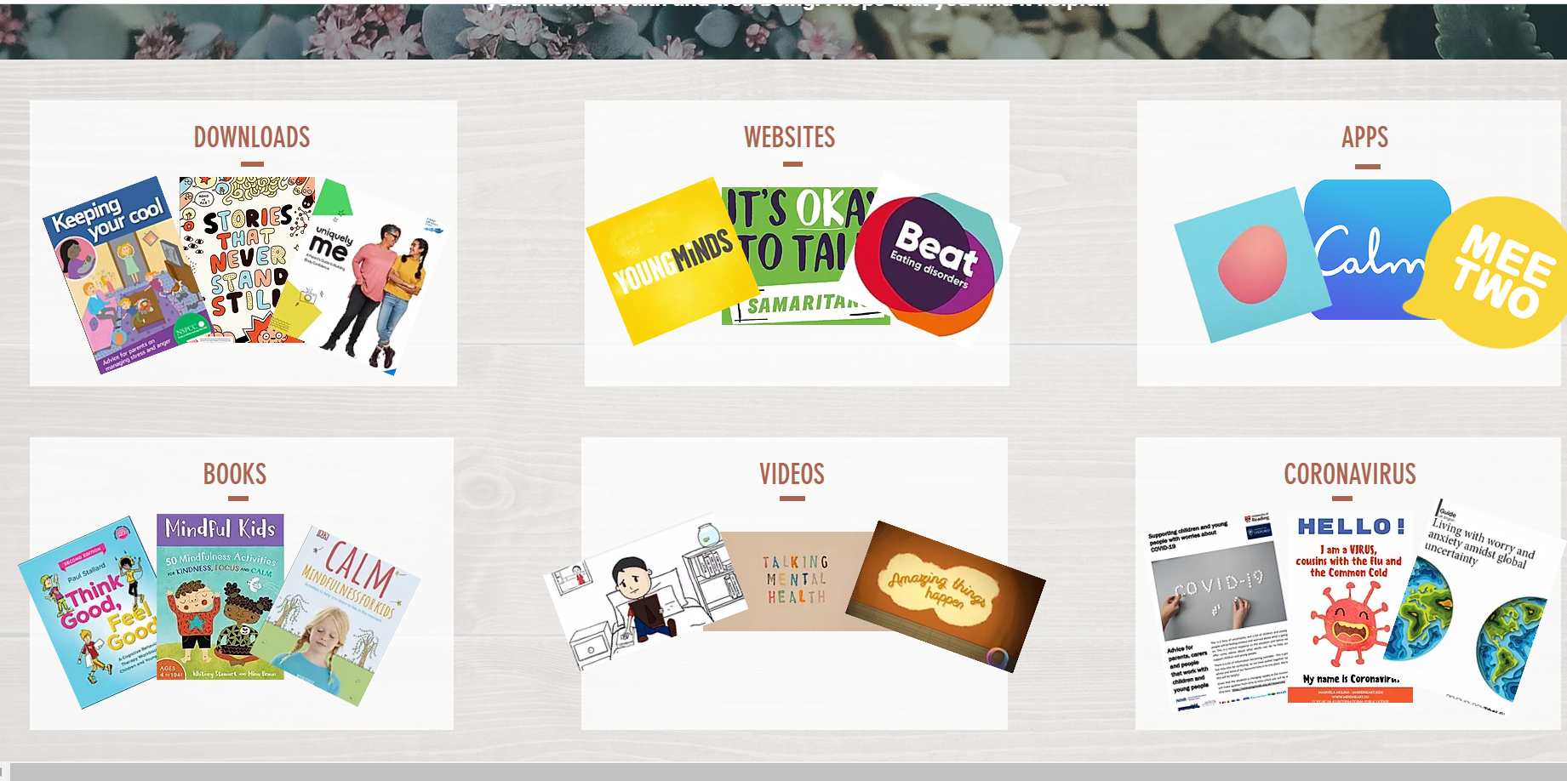
https://www.camhs-resources.co.uk/

Slide 23











Helplines:
Anxiety UK (text number): 07537 416905
Beat (Eating Disorders): 0808 801 0711
CALM: 0800 58 58 58
Childline: 0800 11111
MIND: 0300 123 3393
National Self-harm Network: 0800 622 6000
Papyrus (suicide Prevention): 0800 068 4141
Samaritans: 116 123
Sane: 0300 304 7000
Young Minds: 0808 802 5544
Websites:
Anxiety UK: www.anxietyuk.org.uk
BEAT (Eating Disorders): www.b-eat.co.uk
CALM: www.thecalmzone.net
Childline: www.childline.org.uk
Depression UK: www.depressionuk.org
MIND: www.mind.org.uk
National Self Harm Network: www.nshn.co.uk
PAPYRUS: www.papyrus-uk.org
Relate: www.relate.org.uk
Rethink Mental Illness: www.rethink.org
Samaritans: www.Samaritans.org.uk
Young Minds: www.youngminds.org.uk
Apps:
Calm Harm: Support for Self-harming Behaviours
Calm: Meditation
Clear Fear: Anxiety Support
Headspace: Mindfulness
Mindshift: Anxiety Support
Sleepio: Sleep Improvement
Smiling Mind: Mindfulness
Stop, Breathe & Think: Guided Meditation

